Slide 1
Software Developer Hiring Process
538 – Waxler, Brodsky, and Galligan

Slide 2
Recruit / Solicit Resumes
Interns
NRIEP - https://nreip.asee.org
Career fairs
Employees
Post job on handshake - https://app.joinhandshake.com/login
Attend college career fairs – You can find them by visiting the college websites or on handshake (if the college is a member of handshake
Indeed (https://www.indeed.com/) – not very successful
Notes:
We are having trouble hiring mid-late career developers and need a better way to solicit interest.

Slide 3
Select Resumes for Interview
Sort through resumes to identify likely candidates
For recent graduates consider
Education (Computer Science > Computer Engineering > Information Technology)
Experience (This should be development experience)
Projects - Should explain the projects that the candidate worked on and their role on the project. Relevant projects are the best (Example: Web Development if the position is for a web developer)
Portfolio – Having a github account is very favorable. If it has working projects, the candidate should generally be interviewed
Active website
For experienced candidates
Look at experience. Should explain the projects that the candidate worked on and their role on the project
Portfolio and active website preferred but less likely for experienced candidates
Frequency of job changes
Last time they were a developer. (As opposed to a manger or architect)

Slide 4
Phone Interview
Reiterate the applicant must be a US citizen and ability to maintain security clearance (drug free workplace)
Schedule a 30 minute phone interview
Make sure the candidate knows their will be an exercise and is prepared to share their screen. We usually use google hangouts for the screen share.
https://github.com/NIWC-PHL/Recruiting
Username: NIWC-PHL Password: NIWCPhilly1 (This doesn’t work well because of 2 factor authentication)
Database Diagram
Lotto exercise
Simple Web Exercise
Make sure candidate is aware they can use the web to search for syntax and other pertinent information. They be sharing the searched they do as well. They should not search for the exact answer.
NOTE: Exercises presented in the Exercises Section towards the end of this slide deck.

Slide 5
Prepare for In person interview
Provide directions and other requirements to come on base.
Photo ID, up to date inspection if driving, etc.
Inform the candidate that there will be a coding portion of the interview.
Find out what programming language / IDE the candidate is most comfortable with.
Make sure an IDE is set up that the candidate is comfortable with.
Reserve a parking spot for the candidate (if available).
Reserve a room to conduct the interview

Slide 6
In Person Interview – 2 hour
Give an introduction to NIWC Philadelphia and the job
Take Questions
Go over experience, resume, portfolio as desired.
What was their role on group project and teams? What did they do technically (in detail)?
Perform Technical Questions
Candidate is free to ask questions. Candidate should be watched as they code and encouraged to think aloud. They can use google for syntax and definitions but not the exact answer.

Slide 7
NIWC Pacific Formerly SPAWAR Systems Center Pacific (SSC Pacific)
Formerly SPAWAR Systems Center Pacific (SSC Pacific)
Naval Information Warfare Center (NIWC) Pacific provides the U.S. Navy and military with essential capabilities in the areas of command and control, communications, computers, intelligence, surveillance, and reconnaissance (C4ISR), cyber, and space.
Systems development and support includes basic research and prototype development through systems engineering and integration to life cycle support of fielded systems.
NWIC Pacific employs over ~5,000 government civilians
NWIC Pacific employs a highly educated, diverse, multidisciplinary workforce of more than 4,700 scientists, researchers, engineers, technicians, technical specialists and more, who hold 194 Ph.D./J.D. degrees, and 1,356 master's degrees.
The lab, located in San Diego, California, is ranked as a top generator of patents and license agreements (155 patent disclosures, 100 patent applications filed, and 50 patents issued in fiscal year 2017).
We are part of the Navy but are not part of the arm forces. Imagine it like working for NASA or the IRS. No service commitment and no forced deployment.
Notes:
https://www.public.navy.mil/navwar/NIWC-Pacific/Pages/About-NIWC-Pacific.aspx

Slide 8
NIWC Philly
~100 government employees and ~XXX contractors
Supports Navy, Air Force, Army, Marine, Coast Guard, NGA, and more.
Primarily perform Cyber Security, Software Development, Design, Systems Engineering, System Administration, System Integration, Engineering Oversight, Logistics, etc.
Opportunity for S&T and RDT&E work.
Apply to get your idea funded through consolidated S&T proposal call
Submit patents to get bonuses

Slide 9
Overview of Software Development Work
Describe the software development work in the division
VRAM
I3
CyberKnight
IACT
Marine Corps (I forget the product name)
Describe the specific opportunity being working on
Notes:
Add as is software development work for division description in more detail

Slide 10
In Person Interview – 2 hour - Questions
Recent Graduate
Prime numbers
30 minute address book. See Additional Slides. Any language. Text or graphical.
Experience Candidate
60 minute address book. (Use programming language of the position candidate is being evaluated for.)

Slide 11
Exercises for Phone Interview

Slide 12
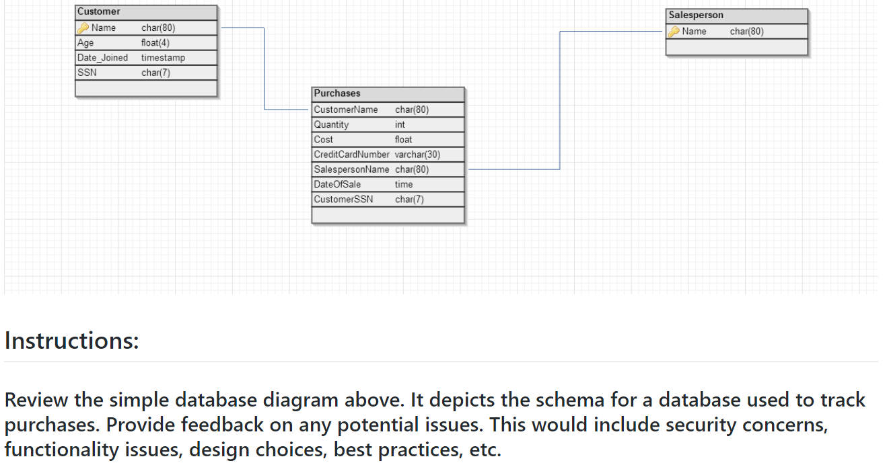
Database Diagram

Slide 13
Lottery Question
Time Limit: 15 minutes
Language/Platform: Your choice
Create an application in any language of your choice that does the following:
Generates a lotto ticket (using any method you like)
A lotto ticket is a set of three numbers that range from 0-20.
Generates a set of winning numbers, and check if the ticket is a winner
Repeat step 2 until a winner is found.
Optional:
Display the number of "days" taken to win the lotto
Display the winning numbers / your ticket
Display the odds of winning on any single "day"
Add a fourth 'bonus' number where you win a bonus prize (can only be claimed if you win the first three)

Slide 14
Lotto Example output
Example lotto tickets:
05-18-20 13-15-19 1-4-17
Example output:
>.\lotto.php
Your lotto ticket is 04-11-20.
Guessing....
Found a winner after 10395 guesses!
The winning ticket was 04-11-20.
>.\lotto-bonus.php
Your lotto ticket is 04-11-20-(7).
Guessing....
Found a winner after 10395 guesses!
The winning ticket was 04-11-20-(3).
You did NOT win the bonus multiplier.

Slide 15
‘Simple’ Web
Link: https://codepen.io/mgallig/pen/xvYxWj
Instructions:
You are provided a form on bottom section of page. The HTML, CSS, and JS for the form are located in the upper section of the page.
The form takes three fields:
a. An email (text box)
b. An awesome developer field (a true/false checkbox)
c. An explanation (text box)
Upon clicking the 'submit' button, the page should alert with the entered values.
Test this functionality and debug any errors you find.
Discuss any design changes or improvements you recommend. No need to implement.

Slide 16
Exercises for In Person Interview

Slide 17
Primes
Create a program that calculates and outputs the first 100 prime numbers.
Candidate may search the internet for syntax but not to search for the answer to the question.
Candidate may also search for the internet to validate their answer when output is required.
Encourage candidate to think aloud.
Time: ~20 minutes
Notes:
Candidates that complete this almost always output the prime numbers less than 100. This is considered successful. Many candidates fail this exercise. Candidate is not required to get the correct output their first time running the program. They should be encouraged to check and trouble shoot their answer.

Slide 18
Address book Question
Create an address book
Optimally, it will perform basic CRUD functions - Create, Update, and Delete
Optimally, it should include Name, Address, and Phone Number
Time: ~30 minutes
You are not expected to finish this problem. You are expect to have code that compiles and that completes a can perform a meaningful function.
When complete we will talk about next steps. What did you implement? What do you wish you had time to implement?
What would you do if given the rest of the day to complete this project? How about the rest of the week?
For experience candidates, they should be given an hour. They should use the programming language they will be expected to use if selected.

Slide 19
Rubric for Grading Exercises
Does the program run / compile?
Do they check their answer?
Create a test case?
Create an object?
Do they break down the problem in a logical way?
Do they achieve the challenge?
Things to consider:
How do they go about trouble shooting? (Subjective)
Notes:
1 through 5 scale instead of yes or no questions?

Slide 20
Database Interview Question
Not currently in use

Slide 21
SQL Exercise – Setup (not currently in use)
https://www.db-fiddle.com/f/eQ3wL4rzw4xevuLZ31szJt/2
CREATE TABLE grades (
class varchar(200),
student varchar(200),
grade int
);
INSERT INTO grades (class,student,grade) VALUES ('Math','Jonathan',90);
INSERT INTO grades (class,student,grade) VALUES ('Math','Heather',100);
INSERT INTO grades (class,student,grade) VALUES ('Math','Matt',95);
INSERT INTO grades (class,student,grade) VALUES ('History','Alison',85);
INSERT INTO grades (class,student,grade) VALUES ('History','Pam',95);
INSERT INTO grades (class,student,grade) VALUES ('History','Nhan',80);

Slide 22
SQL Exercise - Answer
SELECT * FROM grades ORDER BY class, grade;
SELECT grades.*
FROM grades INNER JOIN
(
SELECT class, MAX(grade) AS highest_grade
FROM grades
GROUP BY class
) AS BB ON grades.class = BB.class AND grades.grade = BB.highest_grade

